Slide 1
Our New Learning Innovative Network for Education

Slide 2
ABOUT THE PROJECT

Slide 3
Project background
In this critical times of pandemic, six schools decided to team up and create ONLINE project.
Some goals:
to equip teachers and students with skills and knowledge on the use of digital tools
to increase their digital competence and strengthen teachers’ skills based teaching practice through transnational cooperation
to increase their language skills, boost their communication and social skills and collaboration/teamwork

Slide 4
Project background
to improve their socio affective skills through an international approach as opposed to digital technologies isolated at home
to use creativity and innovation, critical thinking, problem-solving and decision-making approaches
to make the most of exchange of good practices and peer-learning
to take personal and social responsibility in unpredictable situation like pandemic of covid-19
to boost their cultural awareness and intercultural understanding

Slide 5
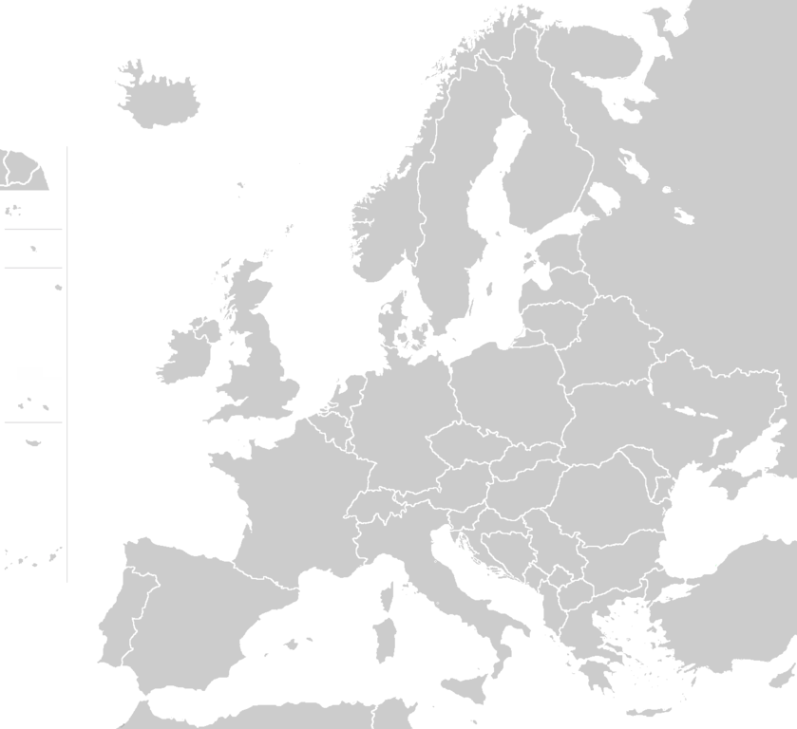
Partner organisations
Italy (Bitonto)
Turkey (Nazilli)
Bulgaria (Mezdra)
Spain (Málaga)
Portugal (Guimarães)
Croatia (Daruvar)

Slide 6
Tangible results:
Non-tangible results:
A collection of didactic materials used during the project, the students in each country will prepare a brochure with the title ‘Digital tools used in online learning’
A collection of videos containing the results of the activities
The project website
Students' blogs
Webinars and online meetings
The students and teachers will:
be able to use different digital tools
grasp their strengths and weaknesses in terms of digital technologies
be able to self-assess the degree of their digital competences
raise their cultural awareness and intercultural understanding

Slide 7
Activities

Slide 8
Bulgaria

Slide 9
Activities by days
Visiting the capital Sofia and meeting other school(s) – discussion about digital education, exchange of good practices
School conference: “Safety on the Net” with all the partner schools
Meeting local authorities
1st
3rd
Visiting Cherepish Monastery
Ritlite rock formations
“Dyado Yotso” monument
Workshop - preparing drawings and brochures
Meeting local IT companies in regional town Vratsa - discussion about cyberbullying
Ethnographic/Historical Museum
Quizzes and questionnaires about Internet safety
2nd
4th

Slide 10
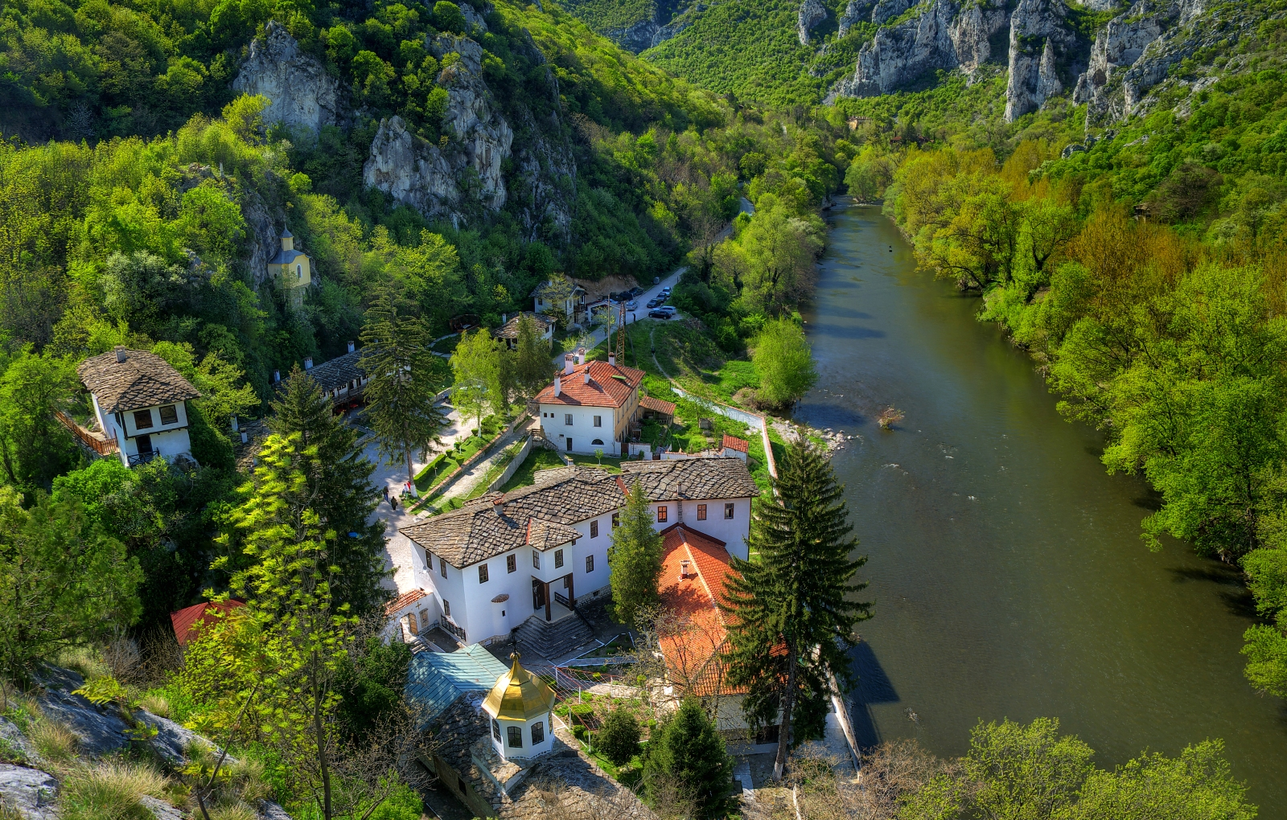
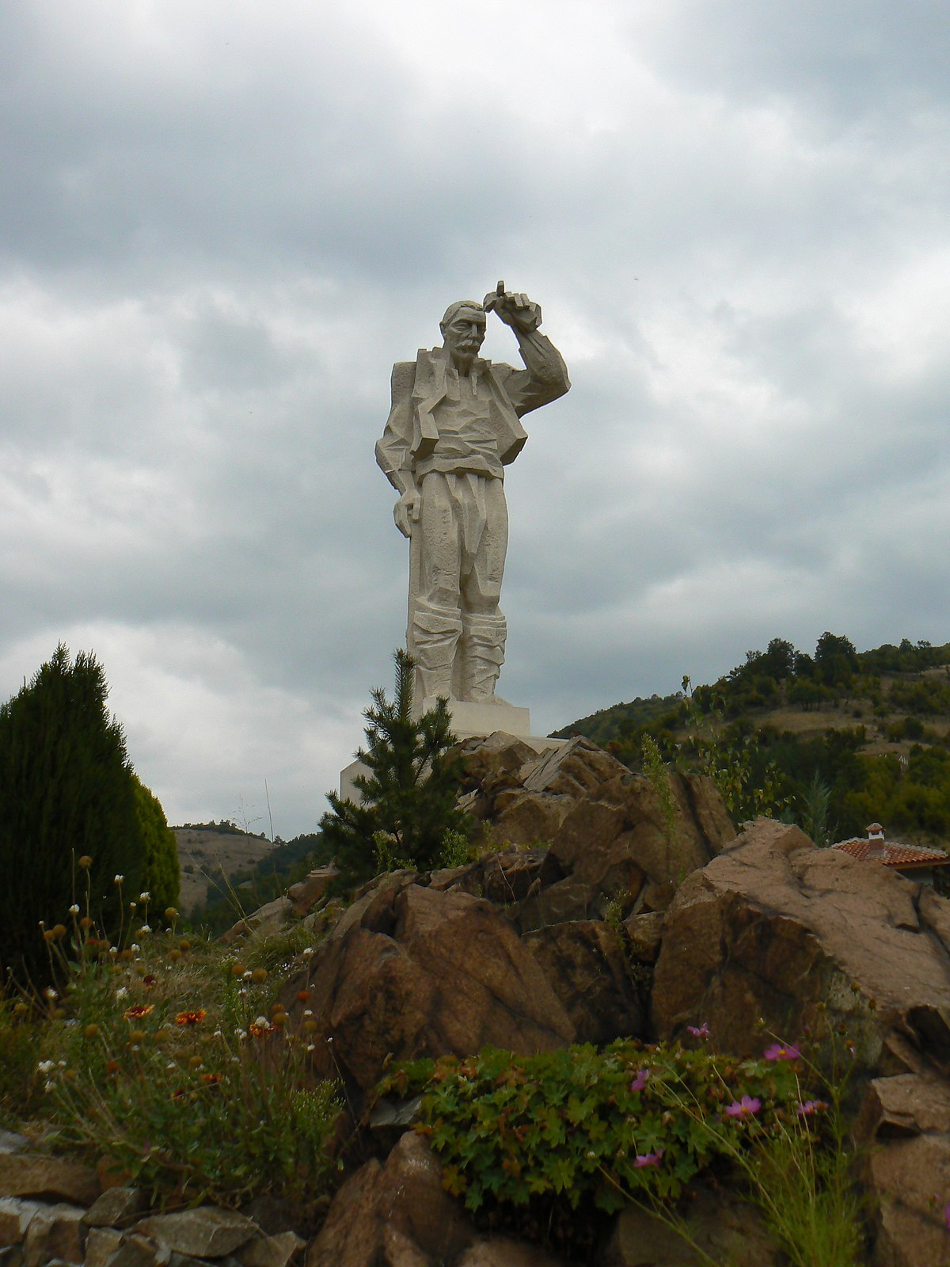
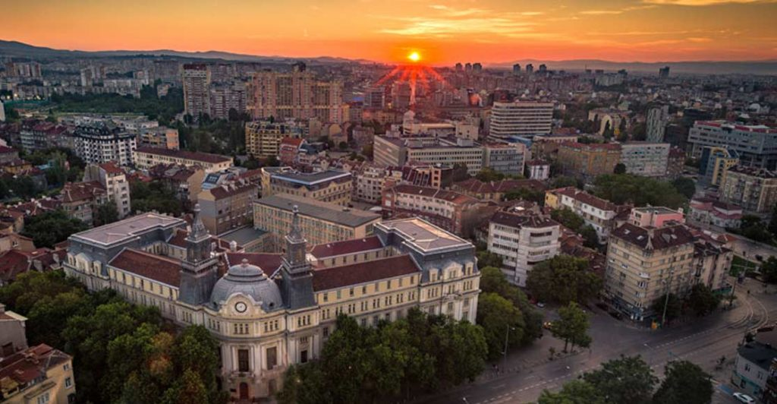

Slide 11
Italy

Slide 12
Activities by days
Workshop: organize photos and product descriptions to be put on sale.
Use the E-Commerce plug-in Power to insert in its page the products with descriptions, images and prices
Workshop: design of a website for the creation of an e-commerce activity through the use of the google site platform
1st
3rd
An expert’s lecture on web design
Workshop: continuation of activities on creation of e-commerce website
2nd
4th
Workshop: Web app testing and debugging

Slide 13
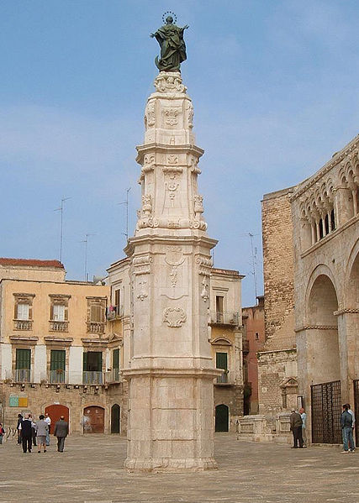
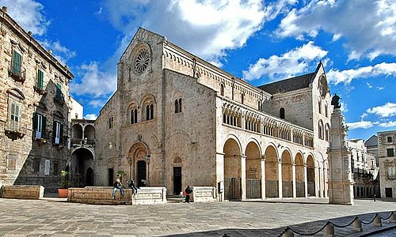

Slide 14
Spain

Slide 15
Activities by days
A UNESCO World heritage site will be visited, assigning the task of documenting monuments with videos, photos
Gathering information and media to later design their webpage about it
Treasure hunt designed by the Department of Physical Education, in which groups will have to scan QR codes to find clues and progress on the hunt
1st
3rd
An organized visit to the most important heritage sites of the city centre to take pictures, videos, use educational apps, note the website address
2nd
4th
A workshop and a nature trail, pictures, video to be later posted on the website

Slide 16
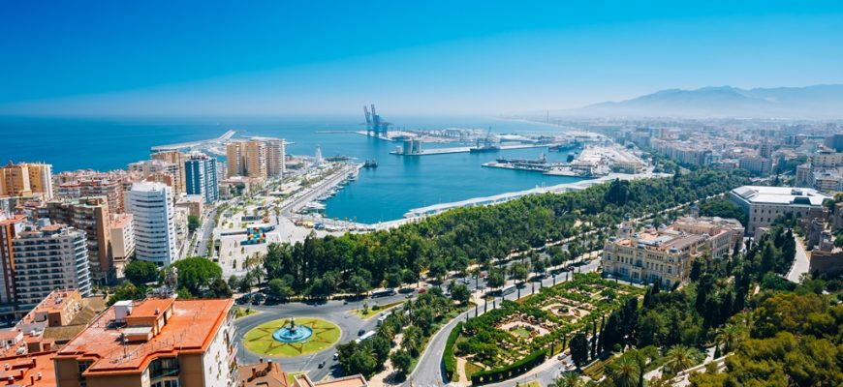
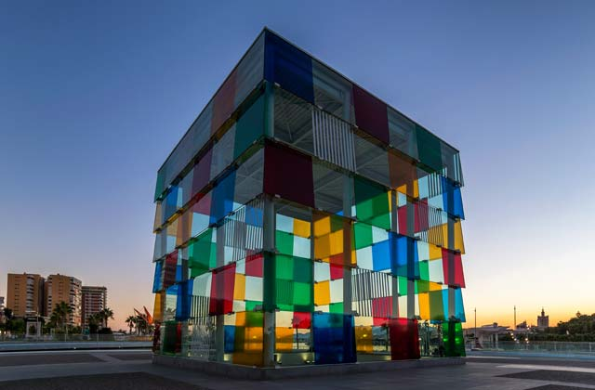

Slide 17
Croatia

Slide 18
Activities by days
Change the Photo workshop – discover the possibilities with the photo processing program.
Visit Zagreb
Mind map field workshop - A tourist brings souvenirs from five regions
1st
3rd
The visit to the Town hall and the town sightseeing tour. Getting to know each other activities.
Photography - change perspective
Culture day Plitvice Lakes. Online exhibition to be organized as a follow-up activity.
2nd
4th

Slide 19
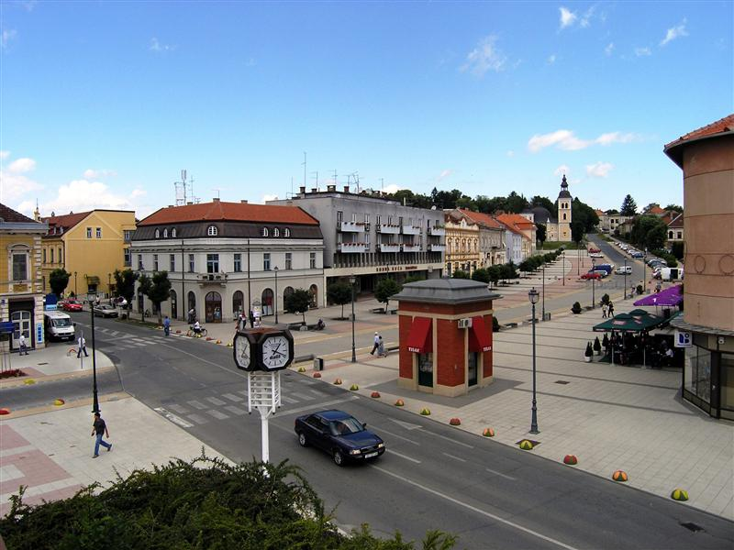
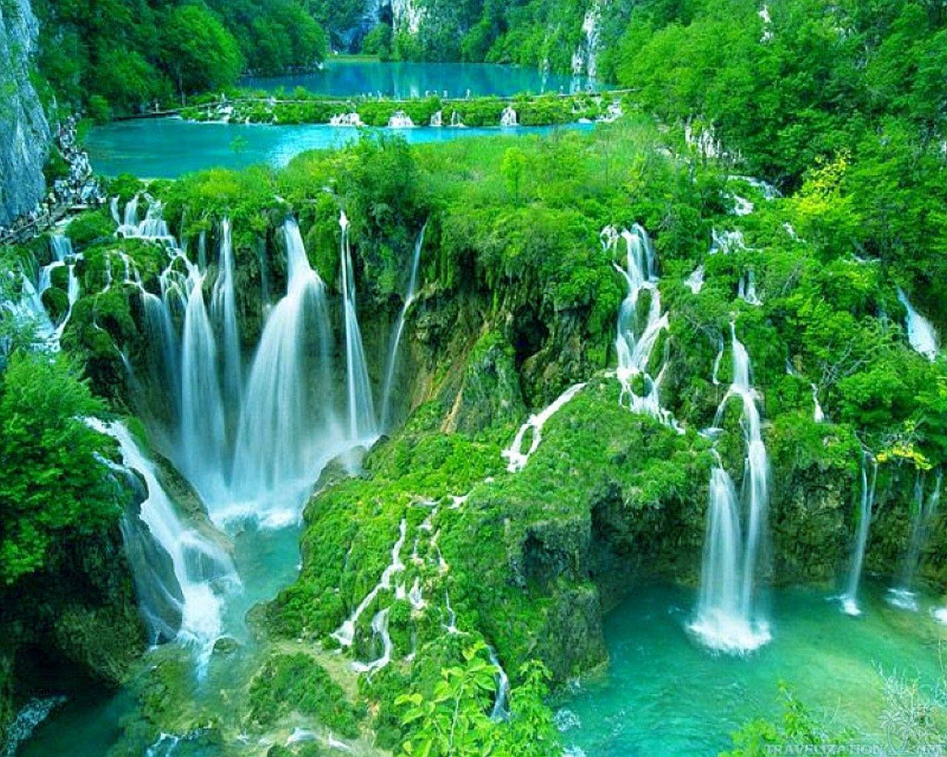
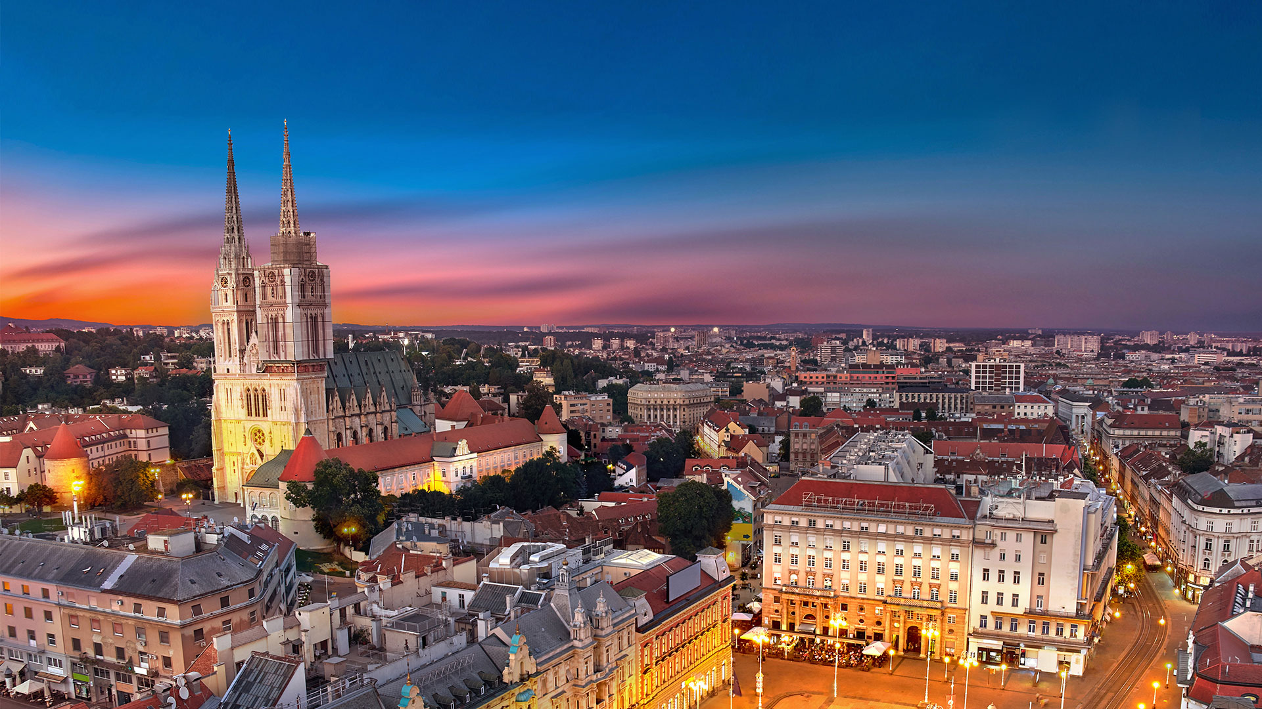

Slide 20
Turkey

Slide 21
Activities by days
Icebreaking games and orientation at school
Meeting school staff, Mayor and local authorities
Outdoor Activity: Taking photos and videos to collect material for video editing in Pamukkale.
Taking photos and videos from a drone
1st
3rd
Staying in bungalows and activities in adventure park in Denizli
Workshops on video editing in international groups
Visiting Kuşadası and Ephesus to take photos for the Project
2nd
4th

Slide 22
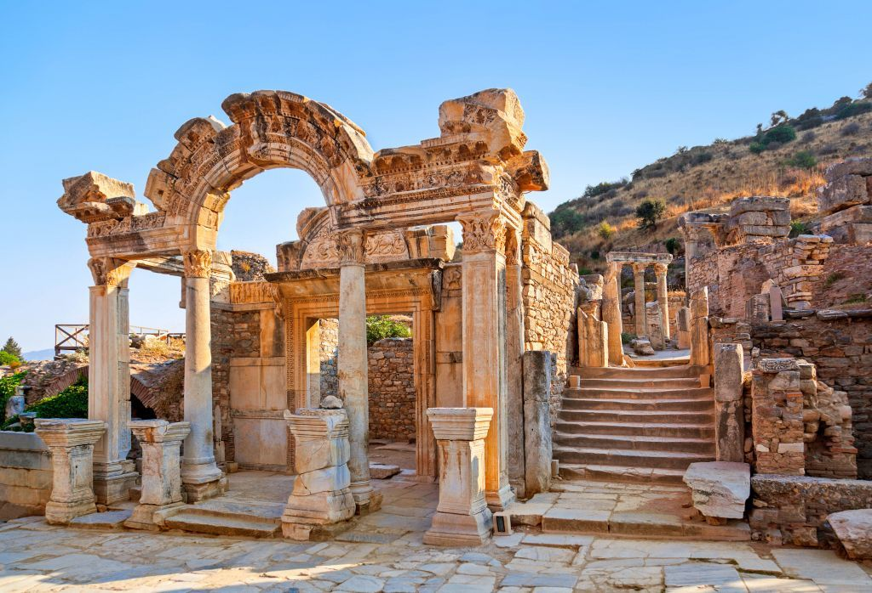
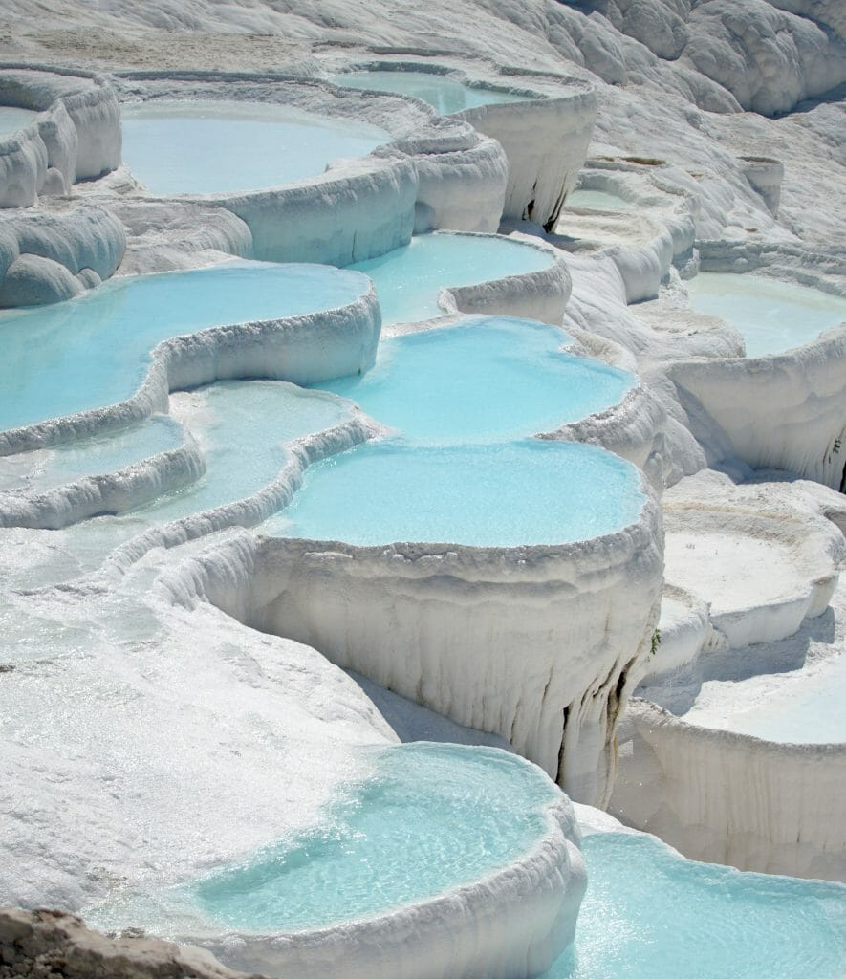
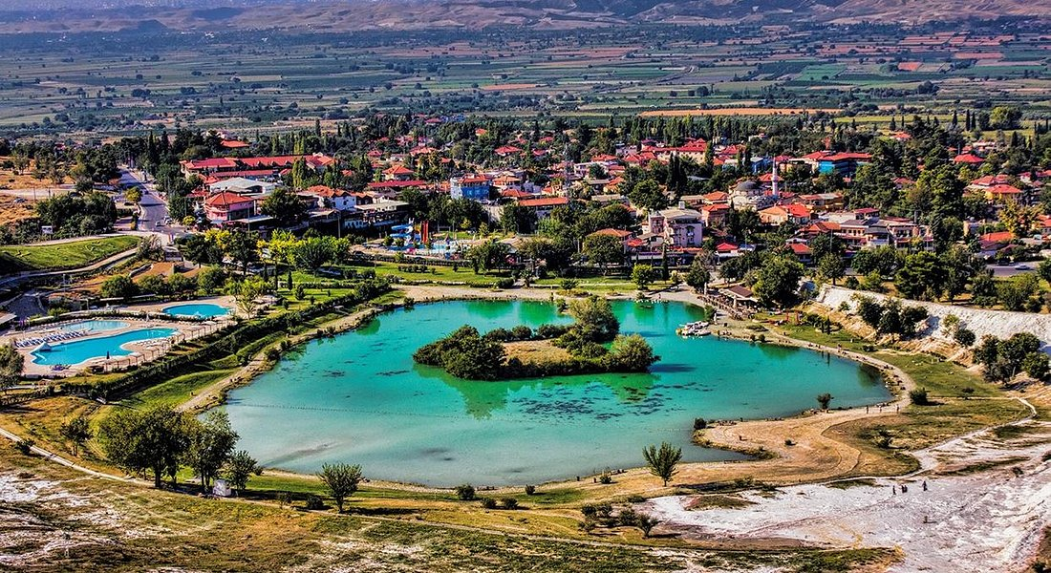

Slide 23
Portugal

Slide 24
Activities by days
LET ́S START- GAME ELEMENTS AND THEIR PEDAGOGICAL ROLE
OUT-OF-CLASS GAMIFICATION STRATEGIES: Game-based learning environments
GAME-BASED LEARNING TOOLS AND APPS: for example Duolingo; Minecraft; Second Life…
1st
3rd
ONLINE GAMIFICATION STRATEGIES: Discussion boards, Quizzes
IN-CLASS GAMIFICATION STRATEGIES
2nd
4th
GAMES WITHOUT FRONTIERS: Evaluation and assessment of the activities

Slide 25
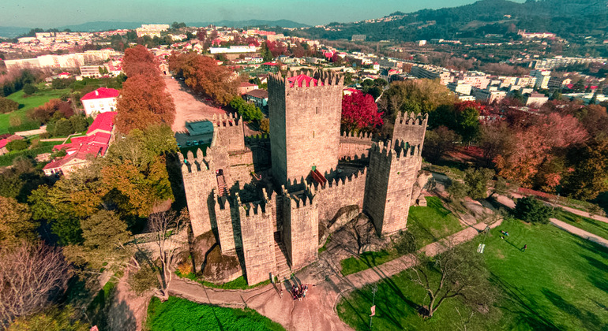
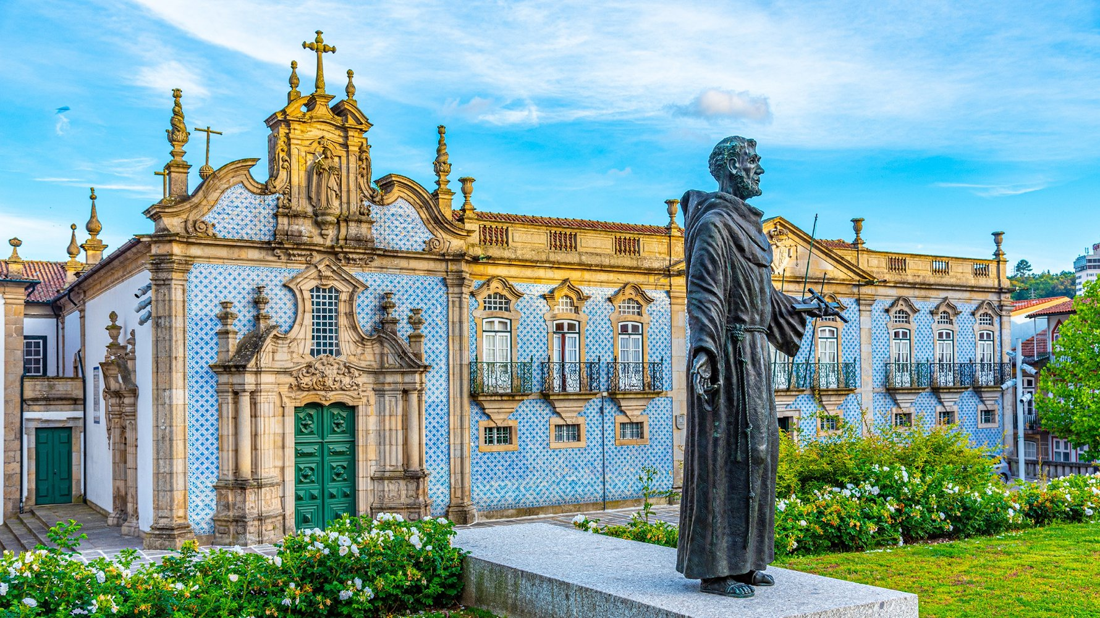

Slide 26
Thank you!

